Slide 1
Class Project: Using Builder Pattern to Build Stocks
CS665, Summer 2021, Boston University
Class Project
Andrew Acord-Serventi

Slide 2
Table of Contents
Summary
Overview
Main Method
BuildStock Class
Stock Class
StockBuilder

Slide 3
Summary
Overall goal: Read from a .csv file containing stock’s information. Build a stock object. Display some relevant stats on the stock to the user.
Design patterns used:
Façade: hides the complexity of reading from the file and building the stock
Builder: allows us flexibility to add or remove elements to constructor and not have a constructor that is extremely lengthy
Took 3 classes – main method, Stock class, and StockBuilder
Builder design pattern is built directly into the Stock class; stock class constructor is private so builder must be used

Slide 4
Overview
Main code is basically for the user input to find the file and name the stock
Main calls the BuildStock.buildStockFromFile method
Method reads from .csv file, extracting data points from the file
Method then uses those data points to call the StockBuilder class and create a stock
Junit tests included and work properly

Slide 5
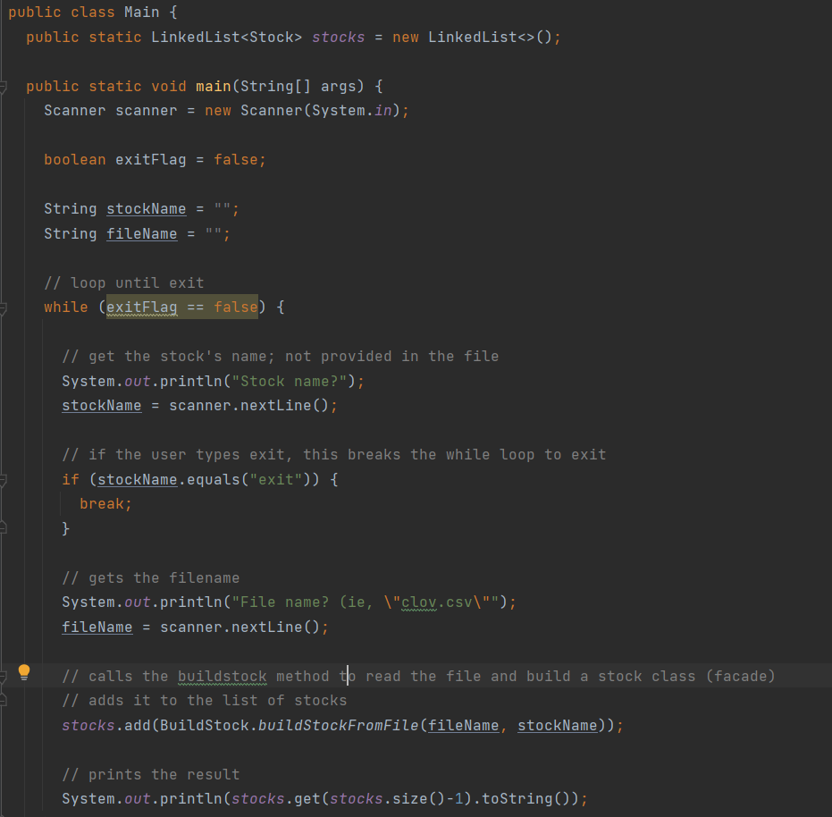
Main Method

Slide 6
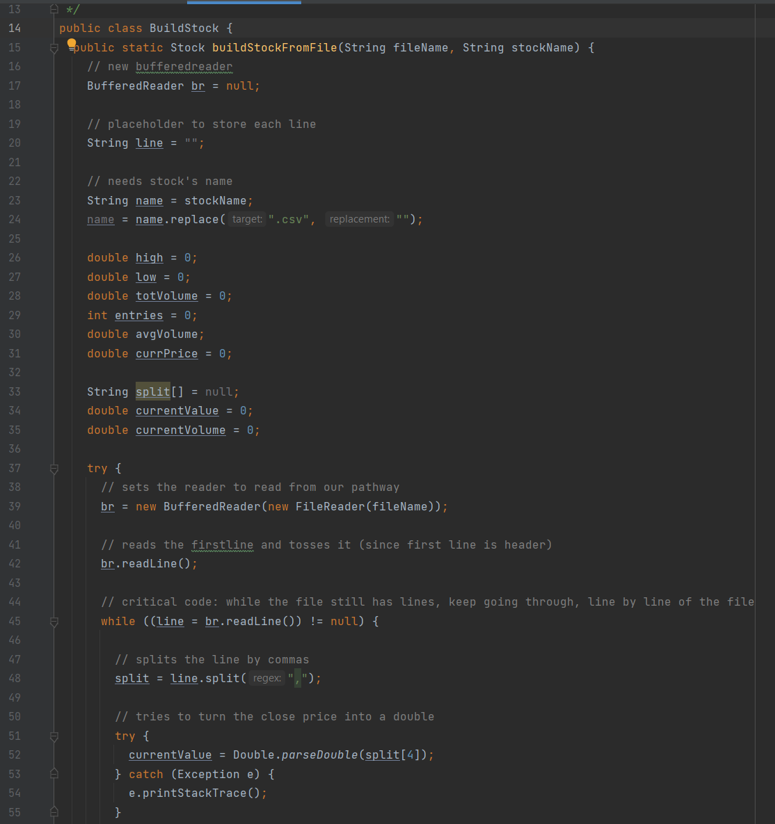
BuildStock Class

Slide 7
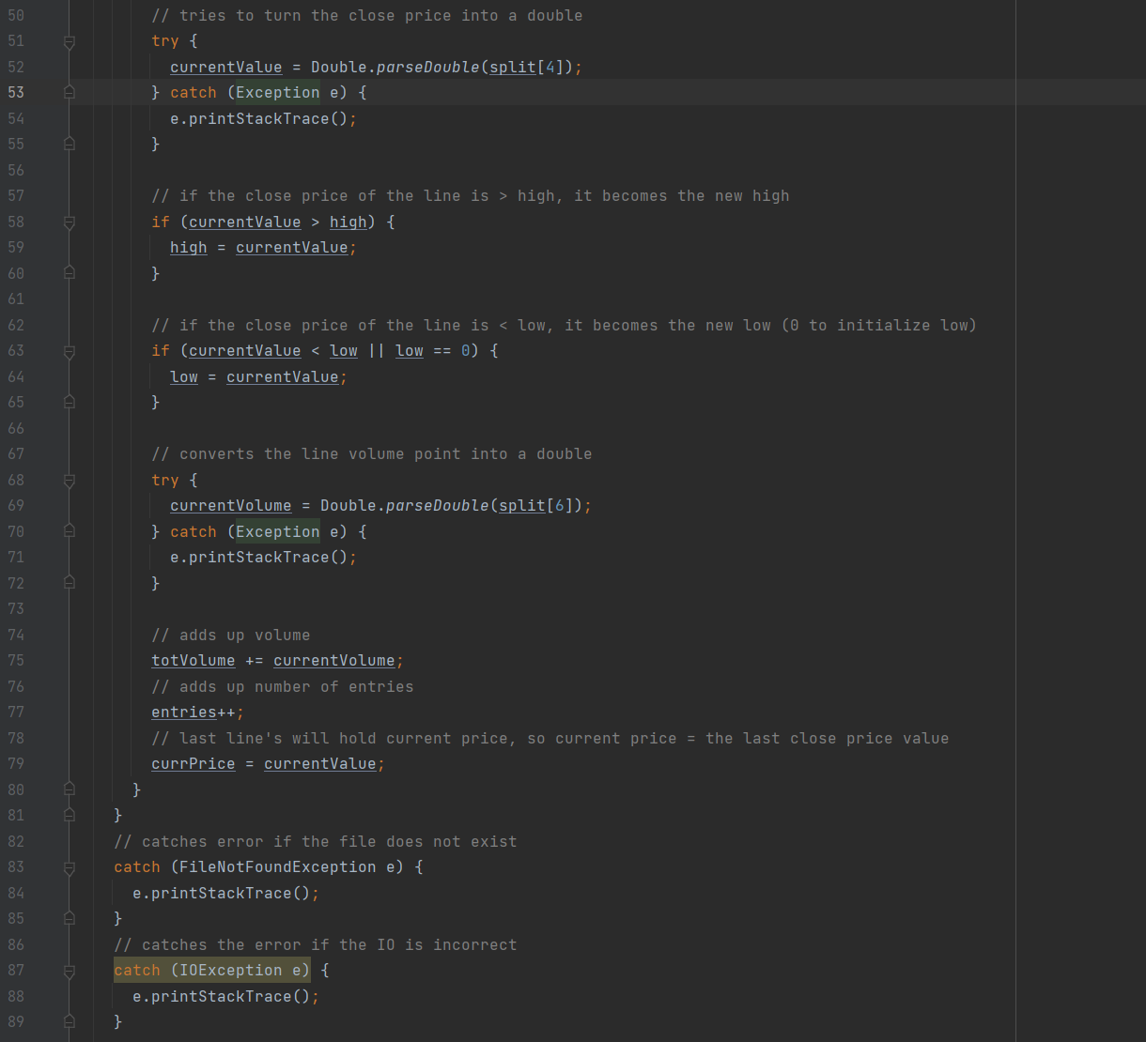
BuildStock Class Cont.

Slide 8
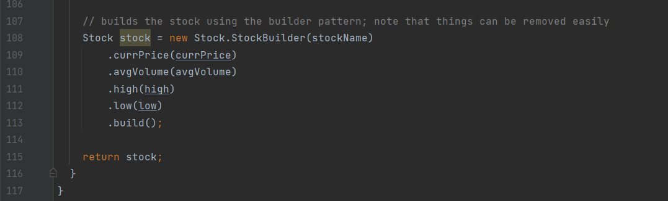
BuildStock Class Cont.

Slide 9
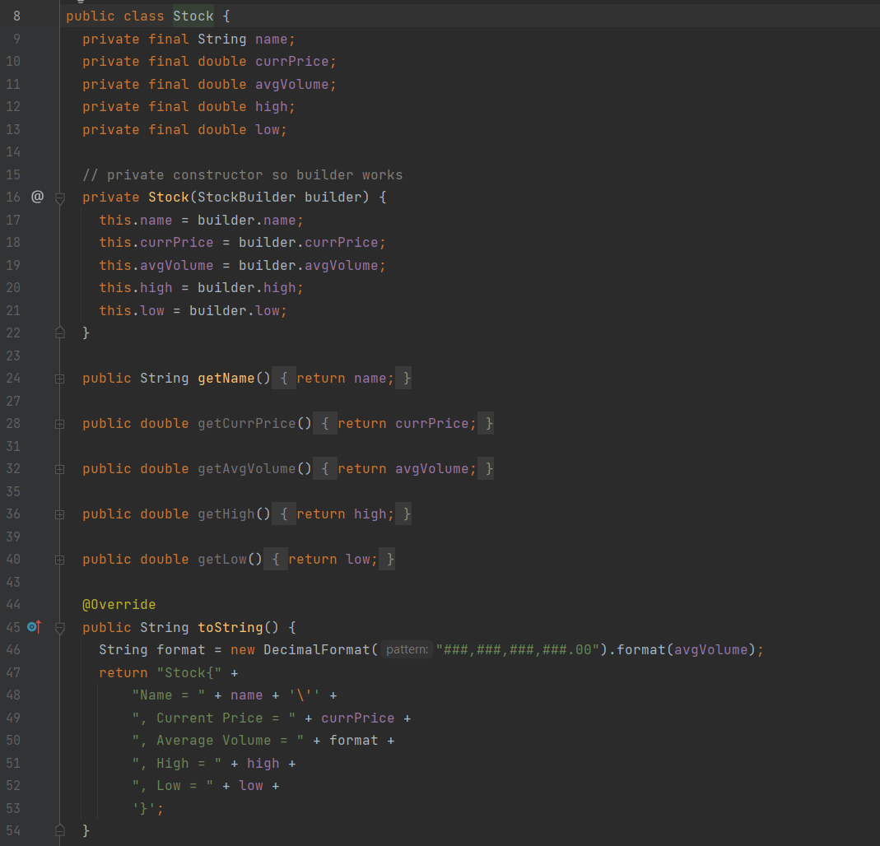
Stock Class

Slide 10
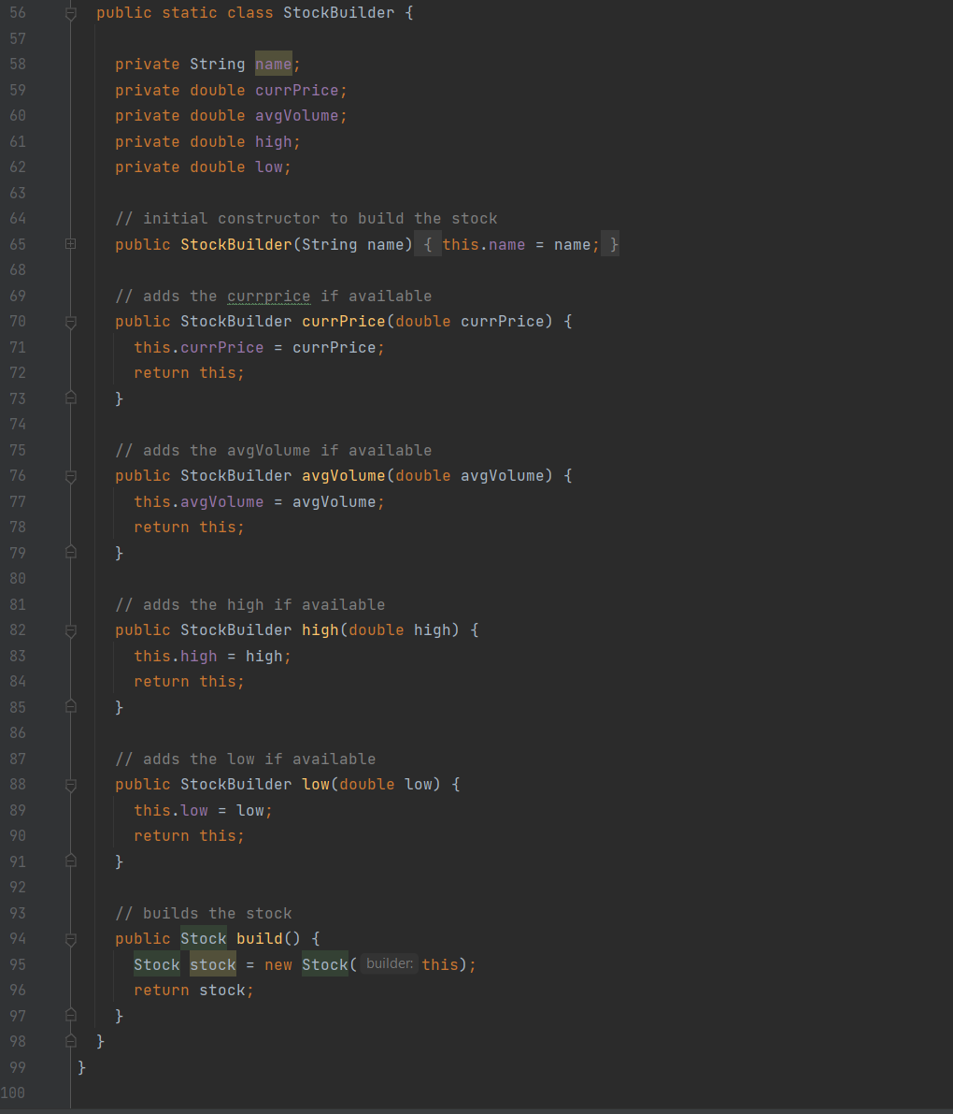
StockBuilder

Slide 11
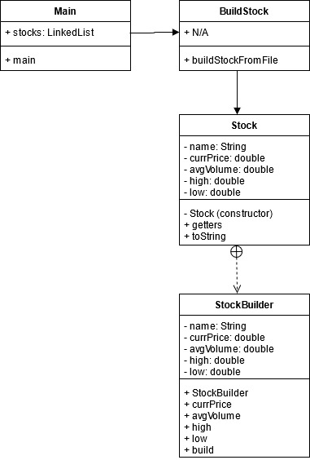
UML

Slide 12
References
Miglani, Gaurav. “Builder Pattern in Java.” GeeksforGeeks, 8 Aug. 2018, www.geeksforgeeks.org/builder-pattern-in-java/.
“Builder Design Pattern.” Java Design Patterns, java-design-patterns.com/patterns/builder/.
Pankaj. “Builder Design Pattern in Java.” JournalDev, 24 Feb. 2020, www.journaldev.com/1425/builder-design-pattern-in-java.

